Slide 1
How to present the methodology of your study
Section 3 Lecture 1: How to present the research sample

Slide 2
Presenting the research sample
Describe who or what you studied
Sometimes referred to as materials
Consider using tables or figures

Slide 3
Research sample: Non-human participants
EW [ca. 90% protein on dry matter (dm) basis] was isolated from commercial eggs as commonly done. Dithiothreitol and sodium azide were from Acros Organic (Geel, Belgium). Sodium dodecyl sulfate, sodium dihydrogen phosphate dihydrate, sodium chloride, and urea were from VWR International (Leuven, Belgium). Bovine serum albumin standard (23209) was from ThermoFisher Scientific (Waltham, MA, U.S.A.). OVA (albumin chicken egg grade III, ca. 94% protein on dm basis), proteinase K (Tritirachium album, P4850), trypsin (porcine pancreas, T0303), and all chemicals (of at least analytical grade), unless specified otherwise, were from Sigma- Aldrich (Bornem, Belgium). Enzyme units (EU) were as specified by the supplier. The highly amylogenic peptide (residues: 103−111) derived from sup35 yeast was produced in-house.
[from Monge Morera M. et al. (2020). Processing Induced Changes in Food Proteins: Amyloid Formation during Boiling of Hen Egg White. Biomacromolecules. https://dx.doi.org/10.1021/acs.biomac.0c00186]

Slide 4
Research sample: Human participants
As far as the qualitative strand is concerned, seventy-six (51%) recruiters expressed their interest in participating in the interview at the end of the survey and provided their contact details. Nevertheless, only twenty-one (14%) responded to follow-up emails and eventually took part. They were also informed about the purpose of the study and signed a consent form. At the time they were working in eight different countries (Spain, the UK, France, Italy, Malaysia, Burma, Chile, and Brazil). No further background data were collected on these participants.
from Kiczkowiak, M. (2020). Recruiters’ Attitudes to Hiring “Native” and “Non-Native Speaker” Teachers: An International Survey. TESL-EJ: Teaching English as a Second or Foreign Language, 24(1).]

Slide 5
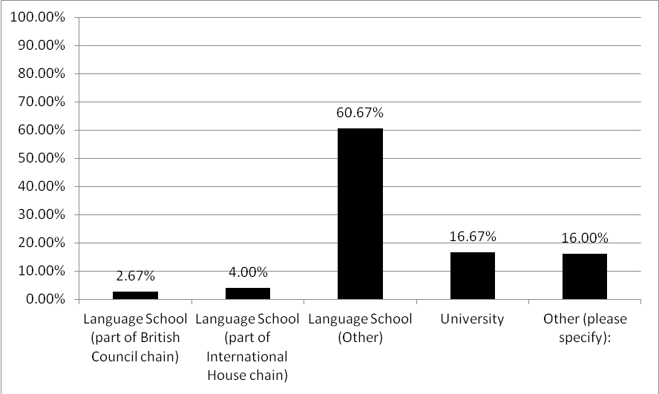
Presenting the sample using tables or figures

